Slide 1
Ormiston Athletics Club Lia Arroyo
AS #91891, #91892, #91893

Slide 2
Website Brief & Requirements
Purpose: The website I am creating is for the admins of Ormiston Athletic Club to enrol club members, view/modify/display their details, fees, and scores.
The website needs to be:
Easy to use/understand
Accessible for all types of users
Dynamically linked to club database
Functional / Be Able to:
Insert and edit kids details, scores, and fees
Display total fees received and total outstanding fees
Display a list of all kids with overdue fees and showing the amount owed
Display a table of members with their total points for the season
Search an event and display all players participated for that event
Search a kid to bring out their points, fees, and view their individual report

Slide 3
Research & Planning
Some Websites I Researched:
Pakuranga Athletics Club
Auckland City Athletics Club
Athletics Nelson
Weymouth Sports Club
In order to make my website, I first have to research similar athletic club websites and analyse the common and relevant website conventions.

Slide 4
Pakuranga Athletics Club

Slide 5
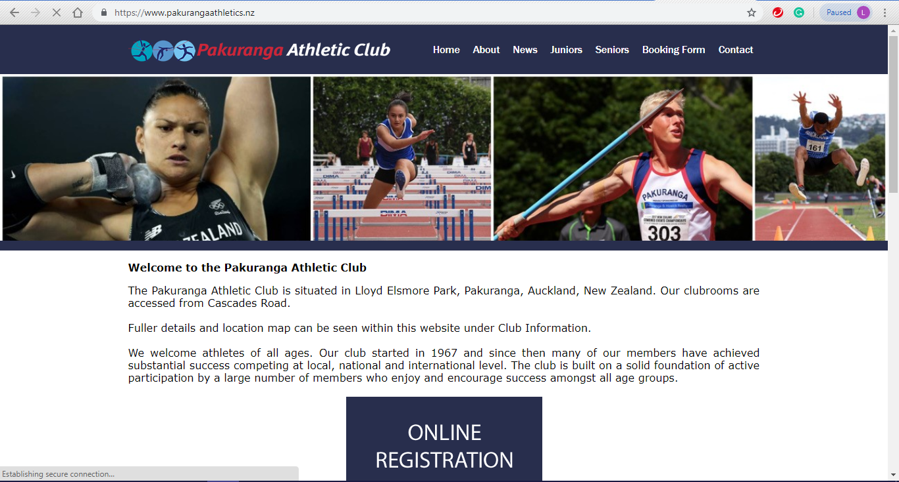
Pakuranga Athletics Club Website - Homepage
Header/Navigation Bar, including logo & club name, and page links.
Slideshow of Pakuranga Athletics Club participants, events and famous athletes
Website brief, explaining what the website is about and what it does
Big button in the middle of the page that redirects you to the registration/login page

Slide 6
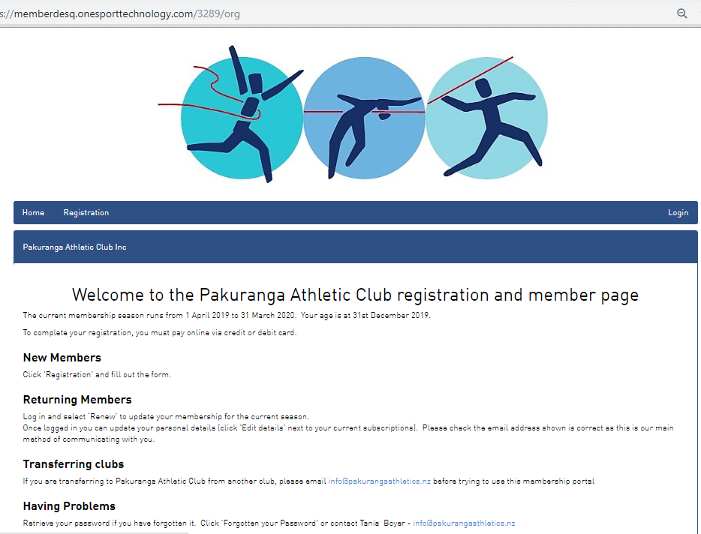
Pakuranga Athletics Club - Registration/Member Welcome Page
When the button is pressed, it redirects us to a different website with different layout. However, we still know it is the Pakuranga Athletic Club by the logo
Login button is on the top-right corner in the header/navigation bar.
A welcome and a brief description of website.
It also contains instructions for different types of users: new, returning, etc.

Slide 7
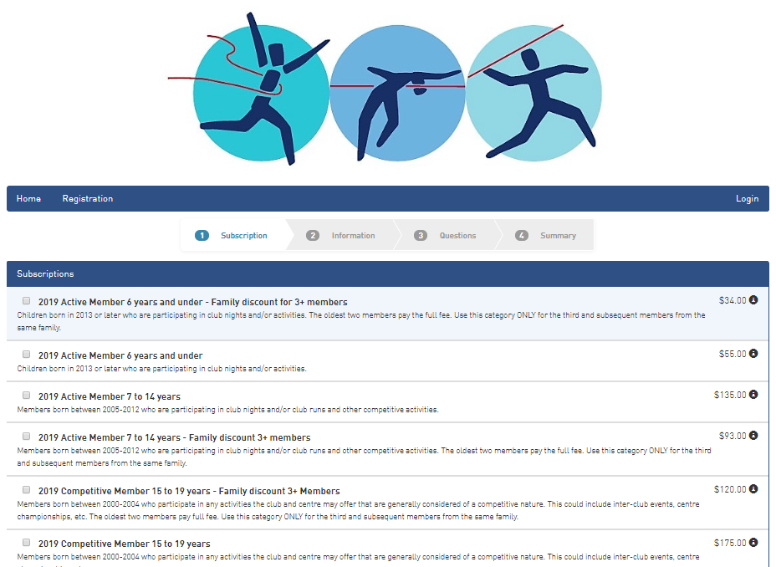
Pakuranga Athletics Club - Registration page 1
Registration Page was split into 4 steps
Shows the different types of subscriptions available, along with a description and the price.

Slide 8
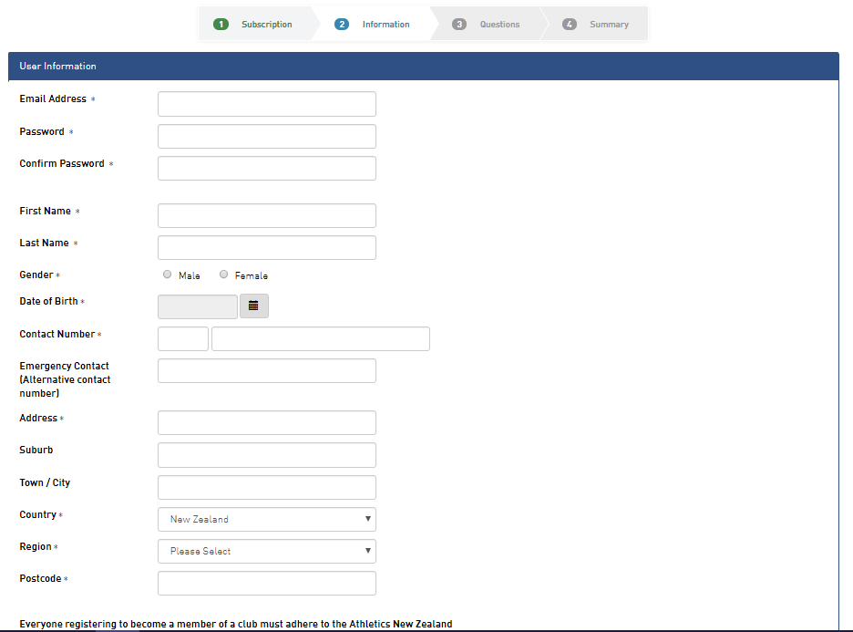
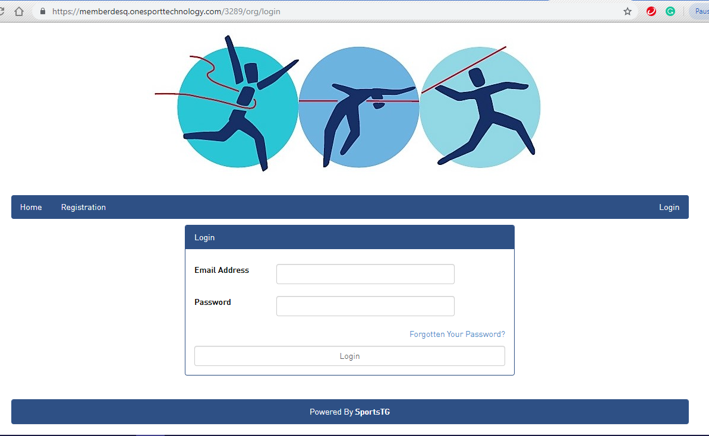
Registration page 2
Login Page
The second part of the registration page has the form which asks for the user’s details such as their First and Last names, birthday and address.
This is what the login page looks like.
It asks for the email address and the password.

Slide 9
Auckland City Athletics Club

Slide 10
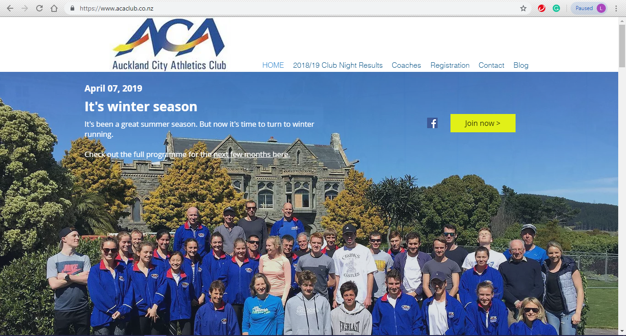
Auckland City Athletics Club - Homepage
Header with navigation bar, website name and logo. “HOME” is a different shade of blue as it is the active page.
‘Join Now’ button and ‘Registration’ button is towards the top right corner of website. They both lead to the same page.
A hero image of what seems to be the club members/staff
Blurb / latest blog post on top of hero image with link to programmes for the following months

Slide 11
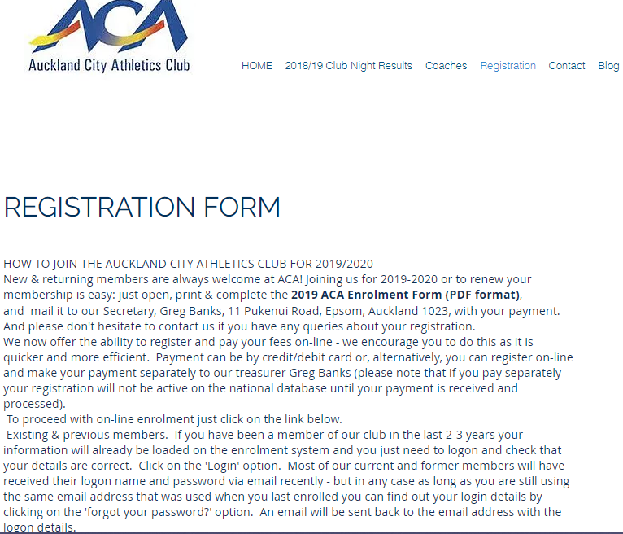
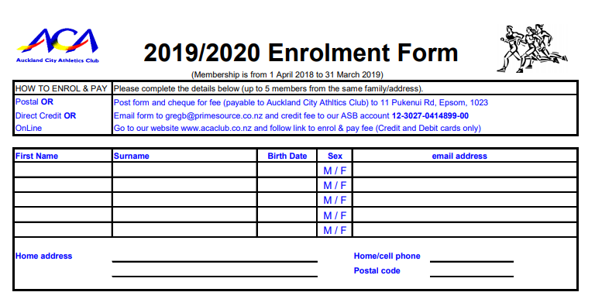
Auckland City Athletics Club - Registration Page
‘Registration’ button is now a different shade of blue (same shade as the ‘home’ button on homepage)
A page title & instructions on how to register
Same header as homepage for all other pages
The registration form is required to be physically mailed to their secretary. A link to a pdf document is attached.

Slide 12
Athletics Nelson

Slide 13
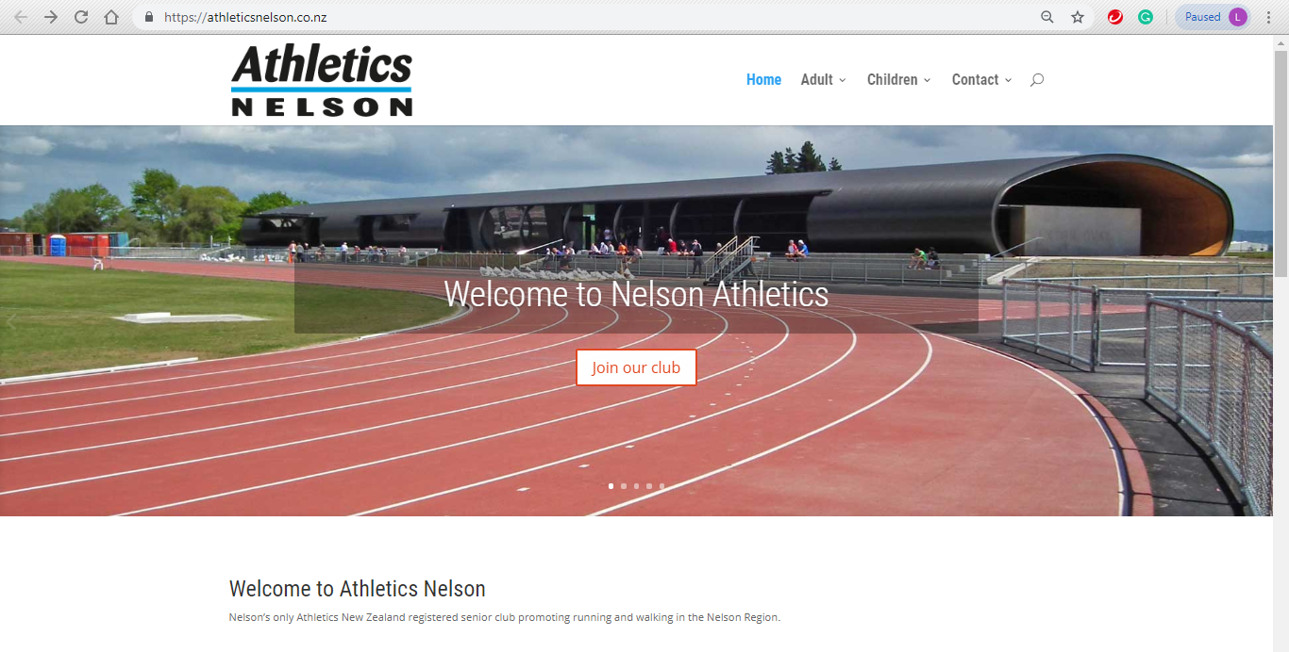
Athletics Nelson - Homepage
‘Home’ button is highlighted blue as it is the current active page.
Header with Logo / Website title and navigation bar (page links)
Page title and register button on top of image slideshow, first slide
Images slideshow, automatically flipping with different text and links. Seems to be flipping too fast though.
On the images slideshow, the title says “Nelson Athletics,” however everywhere else is “Athletics Nelson.” It is confusing for the user as they don’t know which is the correct name for the club.

Slide 14
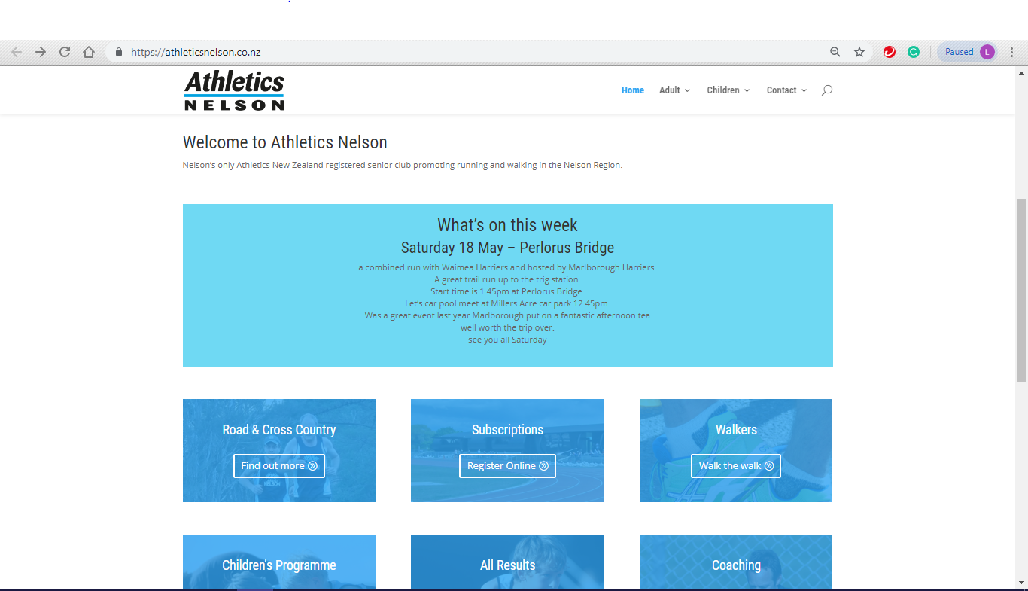
Athletics Nelson - Homepage pt. 2
Header remains the same but smaller in height
A very short website brief and website title.
Displays the latest/upcoming events and a few details about it
A block with a link for each programme that redirects to different pages.

Slide 15
Weymouth Sports Club

Slide 16
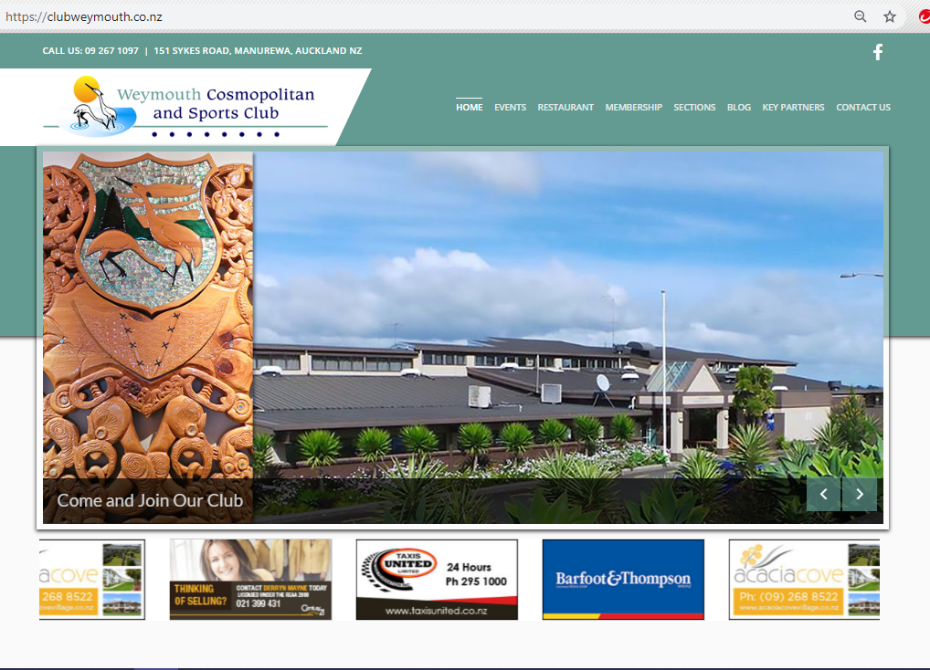
Weymouth Sports Club - Homepage
Header with navigation bar on the right. Club name/website title on the left.
‘Home’ is overlined and a slightly different colour, as we are on the homepage.
An image slideshow. First slide shows the club and urges user to “come and join” their club. Other slides showcase the club features and events.

Slide 17
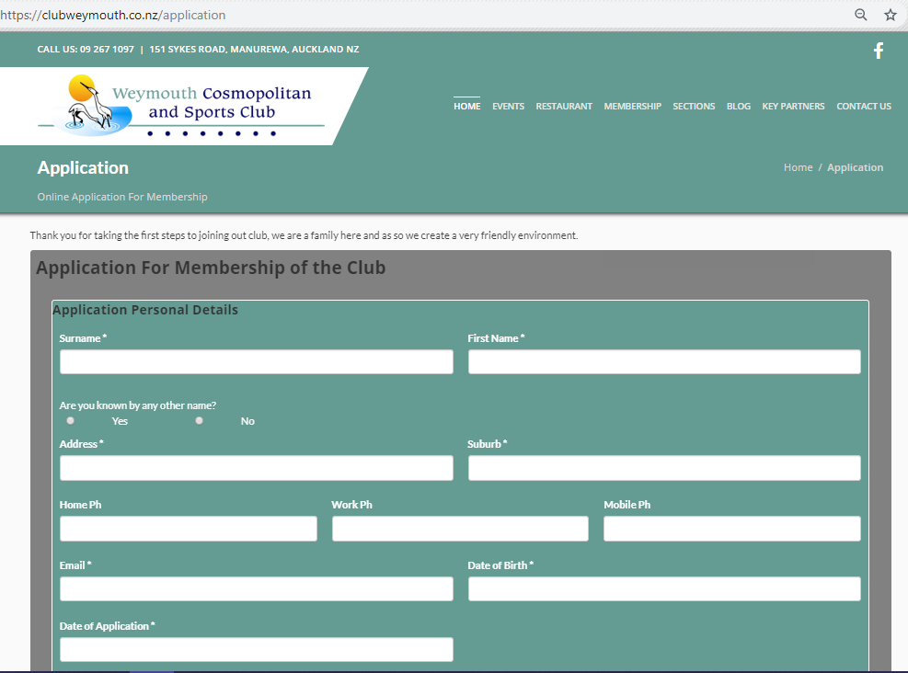
Weymouth Sports Club - Registration/Application page
The same header throughout all pages
A title for the page and a brief description of what the page entails.
It is hard to read black on a dark grey background. Low contrast.
A form which asks for the applicant’s details such as first and last names, address, contact numbers, birthday, etc.

Slide 18
Research Summary
After researching similar athletic/sports club websites, here are the common website conventions that I found:
Login / Registration button is mostly on the top right corner of the website or right in the centre of the home page.
The currently active page button on the navigation bar is highlighted in some way.
Details for the admin/club member to see are secured by a login (the public can’t access)
A hero image or slideshow underneath the header.
A second/separate button in the centre of slideshow or just beneath it
Overall website appearance follows basic design principles: Contrast, Repetition, Alignment, and Proximity.

Slide 19
Website Design Feedback
3 Website Designs:
Design 1
https://drive.google.com/file/d/1H33uYINTdZX5aShIHE7ee6gDPMlRFZo6/view?usp=sharing
Design 2
https://drive.google.com/file/d/1t8uXRTAXx5z_c5qF9ETYuJ961Cceq114/view?usp=sharing
Design 3
https://drive.google.com/file/d/1QuM8FVzzyS4ZJEvmss0LelqbEQn09nLI/view?usp=sharing
To further improve my designs, I went to 3 volunteers with website/design experience and asked for feedback for my 3 designs.

Slide 20
Website Design 1

Slide 21
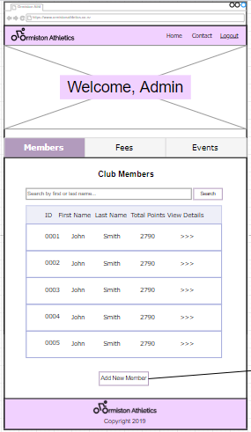
Website Design 1 Feedback - Ms Al Salihi
Pros:
Like that the logo is on the top-left corner and the login button in the top-right.
Liked the different tabs for members, fees, and events.
Cons:
Welcome, Admin image is not necessary / redundant.
Too many members displayed on members and fees page at once is not good, should have a filter.
Add new member button shouldn’t be below the table and should be easier to see.
It is missing a filter for members/fees page.

Slide 22
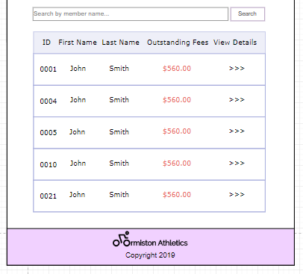
Website Design 1 Feedback - Ms Al Salihi (cont.)
Liked the ‘outstanding fees’ in red in fees table. A common website convention
Colours are subtle and doesn’t pop.

Slide 23
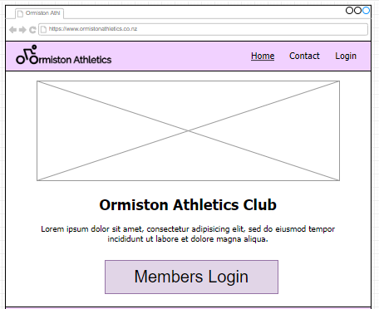
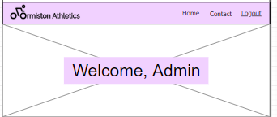
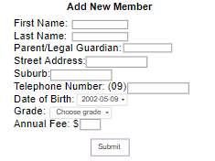
Website Design 1 Feedback - Eugene
Pros:
Overall layout is pretty good, and follows conventions
Cons:
Maybe use a stronger colour?
2 login buttons with different names makes it confusing. (the user might think they're 2 different types of logins)
Welcome, Admin message is unnecessary.
Add new members form doesn’t have good alignment. Looks messy

Slide 24
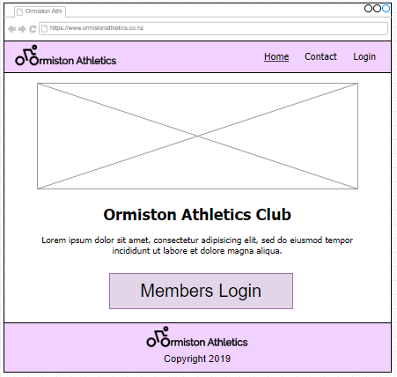
Website Design 1 Feedback - Ms Morris
Likes the additional bigger login button, but unclear if it’s different to the first login button (top right)
(and if it’s for members or admin?) should be clear and consistent on both homepage and login page.
Likes the idea of the slideshow.
But it would look nicer if the slideshow wasn’t floating (e.g. touching the edges of the website)
Button should have thicker outline so people are sure it is a button
Purple header and footer colour doesn’t relate to Ormiston or Athletics/Sports.

Slide 25
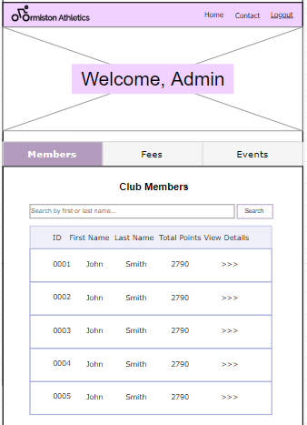
Website Design 1 Feedback - Ms Morris (cont.)
Welcome, Admin + hero image is unnecessary for the members/fees/events pages because it isn’t on the home screen and isn’t public.
Different shade of purple - it is darker than the header and footer colour
The navigation bar links looks like tabs (on same page), but it leads to a separate page instead. Can be confusing/misleading.

Slide 26
Website Design 2

Slide 27
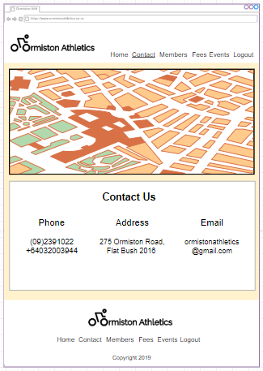
Website Design 2 Feedback - Ms Al Salihi
Pros:
Consistency between pages is nice.
Same header, colours and footer
Like that logo is on the top left
‘Active’ page is underlined
Cons:
Not enough colours
Dislike that the header and footer was white
Contrast is low because the peach colour and white colour are too similar
Logo and links are not aligned
the phone / address / email should be vertical instead of horizontal

Slide 28
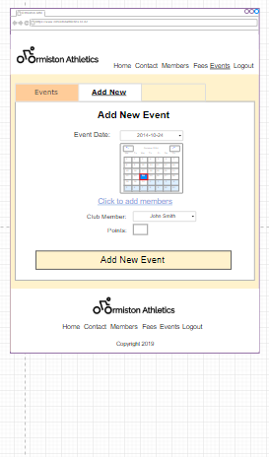
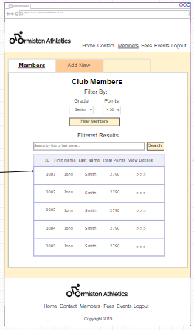
Website Design 2 Feedback - Ms Al Salihi (cont.)
The add members part is unclear and kinda confusing
Filters and the search bar should be on the left side of the page, which is a common website convention

Slide 29
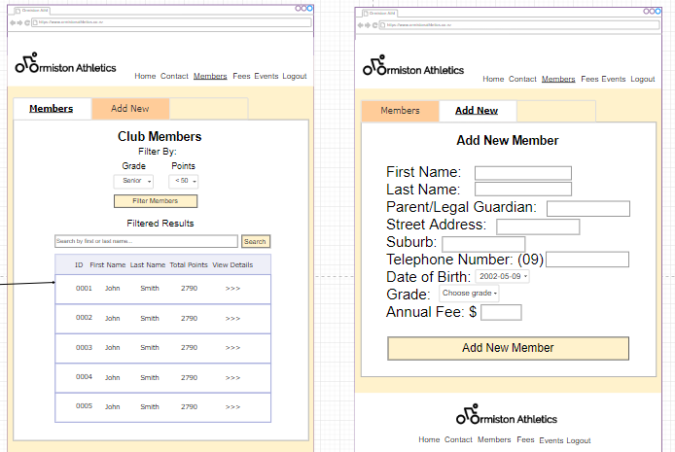
Website Design 2 Feedback - Eugene
‘Body’ colour is too similar to the footer. Not an obvious enough distinction between them.
Filter doesn’t look right. Maybe move it underneath the search or next to your table?
Add New Form alignment is also not great, looks messy.

Slide 30
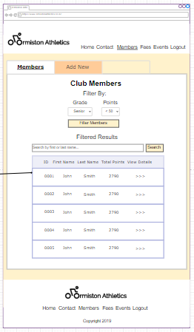
Website Design 2 Feedback - Ms Morris
Likes the orange colour - it relates to Ormiston.
Could be a deeper orange though.
Prefers having the tabs, the orange doesn’t match to the body colour though.
Page titles should be more clearer
Maybe have more white space
Likes having the links at the top appear when logged in.

Slide 31
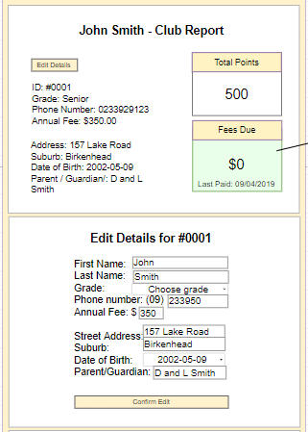
Website Design 2 Feedback - Ms Morris (cont.)
Prefers the edit to be a separate tab underneath the details instead of in Design 1
Likes that the forms are mostly aligned on the right. Would be neater if it aligns on the left as well

Slide 32
Website Design 3

Slide 33
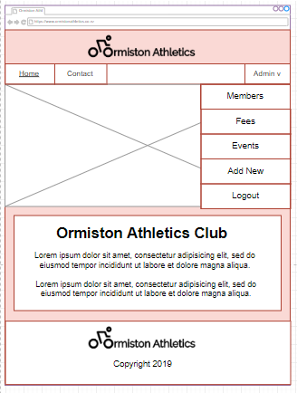
Website Design 3 Feedback - Ms Al Salihi
Pros:
A dropdown menu for admin pages is nice
‘Active’ page is underlined and clear
Home button is on the left, Login on the right
Cons:
Logo is in the middle, was expecting it to be on the left
Colour doesn’t relate to Ormiston or Athletics, and a bit boring

Slide 34
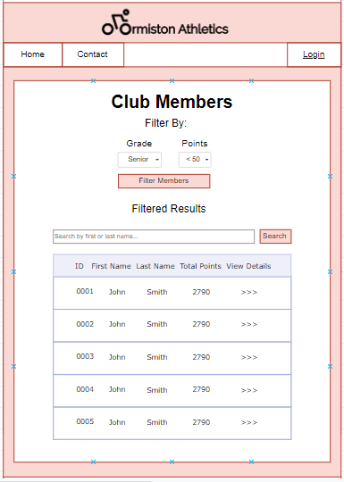
Website Design 3 Feedback - Eugene
Doesn’t like the red border/outline for all the elements.
Maybe a neutral colour like white/grey/black would be better
Body and header colour doesn’t relate to Ormiston or Athletics.
Filter should be next to the table or below the search bar
Likes the dropdown menu for login

Slide 35
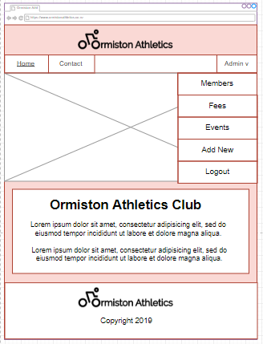
Website Design 3 Feedback - Ms Morris
Likes the drop down menu
But it is too big in comparison to the slideshow and navigation bar
Like that the slideshow is from edge to edge
Awkward/Out of place empty space on navigation bar
Like that active page is underlined
Colours pop more with red outline, but again, doesn’t relate to Ormiston / Athletics.

Slide 36
Feedback Summary

Slide 37
Feedback Summary
Based on the feedback I have received from my volunteers, these were the common comments that I plan to keep in mind as I improve my selected design :
The colours for all three designs aren’t sharp enough / don’t relate to Ormiston or Athletics. A deeper orange, blue or green would be more appropriate.
Filters and search bar should be next to the table instead of on top of it.
The drop down menu from Design 3 is good to have for the admin pages, but should be smaller.
Underlining the currently active page is handy.
Logo should be on the left side, Login should be on the right.
Better alignment for forms especially.
Welcome, Admin from Design 1 is unnecessary.
Adding new event is unclear/confusing, especially the add members part.
Pages are consistent with each other for each design.

Slide 38
Feedback Summary (cont.) - Preferred Designs
Ms. Al Salihi - Design 3
Eugene - Design 1
Ms. Morris - Design 1
Based on their feedback and their preferred design, the design I choose to improve is Design 1 (with the dropdown menu from Design 3), because almost all three of my volunteers and I agree that it has the most potential. Although Ms. Al Salihi chose Design 3, the feedback that she gave for Design 3 can be applied for Design 1 as well.

Slide 39
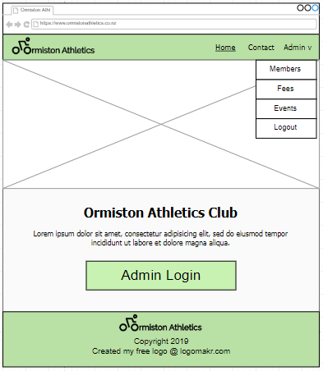
Selected & Improved Design
https://drive.google.com/file/d/1HT0Wh38D4BkhhD_lEVT459nVYXC3ffk9/view?usp=sharing
Following my design feedbacks, I chose to improve Design 1. Here is the final improved design.

Slide 40
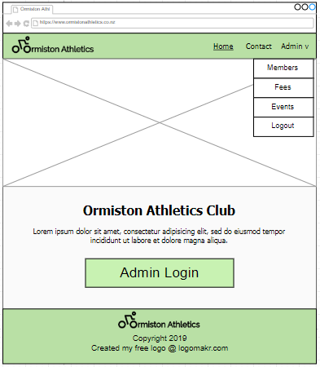
Design Improvements - Index / General
Changed colour from purple to green to relate to Ormiston (club colour) and also Athletics (grass is green, green is a sporty colour).
Slideshow now goes from side to side based on the feedback from Ms. Morris, and because it is a common website convention (as evident on Athletics Nelson and Auckland City Athletics website)
The drop down menu from Design 3 is a favourite across all three of my volunteers, so I decided to implement it in my improved design. I made sure it was smaller than the slideshow so it doesn’t block the images.
I included credit for my logo in the footer to honour copyright.

Slide 41
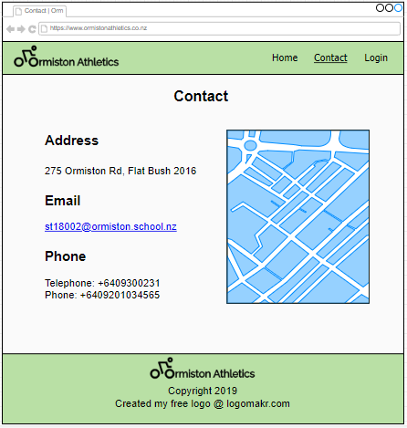
Design Improvements - Contact page
One of my volunteers mentioned that when the address/email/phone was horizontal, it was difficult and confusing to read. Therefore, I made the contact details vertical so that it is easier to read/understand.
I moved the map to the right of the text so that the right side doesn’t feel empty next to the contact details.

Slide 42
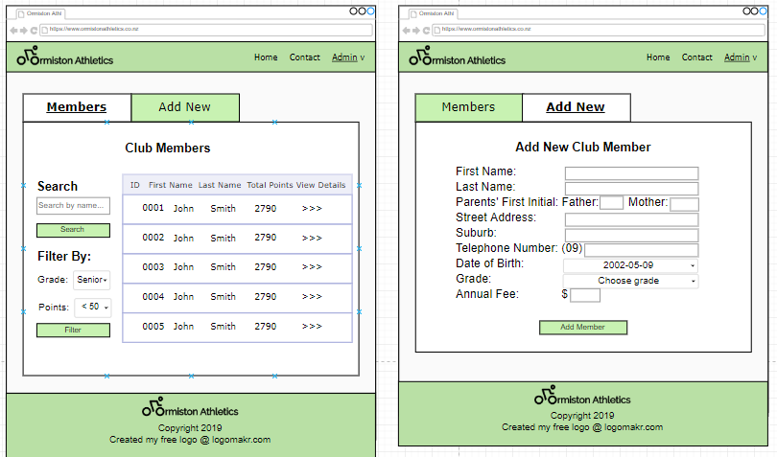
Design Improvements - Members page
Totally removed the “Welcome, Admin” and image as it was redundant.
Added tabs for the Add New Members page because it is neater and easier to access than putting the form underneath the table.
The search bar and the filter is moved to the left of the table instead of on top of it because it is a common website convention.
Aligned all the textboxes so that it is neater and because alignment is important for the aesthetics of the website to please the users.

Slide 43
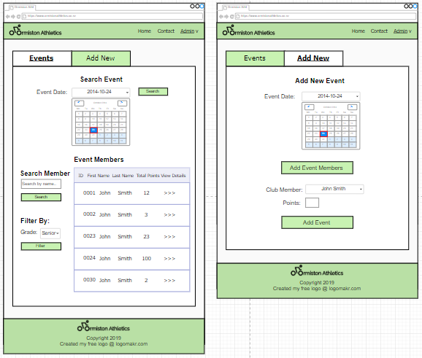
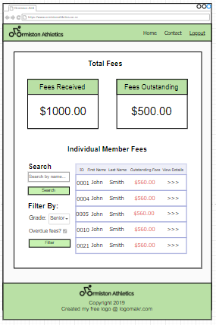
Design Improvements - Events and Fees pages
Same changes from Members page to Events page
Made the ‘adding members to event’ clearer by turning it into a button and naming it properly: “Add Event Members” instead of “click to add members”

Slide 44
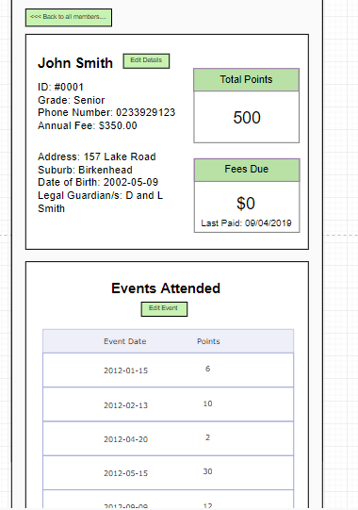
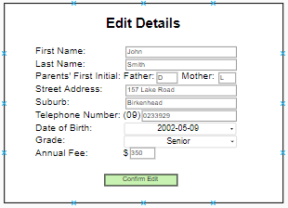
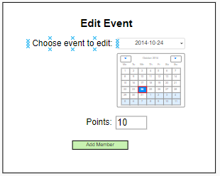
Design Improvements - Club Member Report page
I turned the ‘back to all members…’ into a button instead of just a link so that it is clearer for the users that it is clickable.
I changed the way the editing details and event scores work. Instead of editing on the spot, I decided that it would look neater and would avoid confusion if the edit details appeared in a separate container underneath the report/events.

Slide 45
Relevant Implications
Aesthetics / Website Appearance The overall appearance of the website should follow basic design principles (CRAP): Contrast, Repetition, Alignment, and Proximity. This helps the users navigate through the website with ease and users are more likely to stay if the design is appealing. This is important because the appearance directly relates to the effectiveness of the website.
Copyright Copyright is important to address in a website because it is illegal not to, but also because you need to seek permission to use images/videos/code/art/etc. and/or give credit to the owner.
Accessibility Accessibility is also important to keep in mind because you want the website to be able to appeal and to be used by all different types of users.
These are some relevant implications that are important to keep in mind whilst designing a website.

Slide 46
Relevant Implications
Sustainability / Future Proofing When designing a website that is going to be used for a long amount of time, and the data is expected to grow, it is important to keep in mind how to allow for that. For example: storing data efficiently, ability to edit data, etc.
Privacy Privacy is important especially when dealing with sensitive information such as names, addresses, phone numbers, bank accounts, etc. Sensitive information needs to be protected from the public.
These are some relevant implications that are important to keep in mind whilst designing a website.

Slide 47
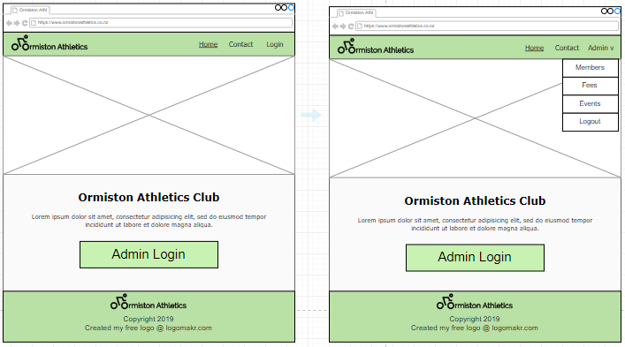
Justification of Chosen Design - Index Page
I chose to have the logo on the top-left and the login button on the top-right of the page as it is a common website convention, so that the users will be able to find it easily where they’re expecting it to be.
Before login:
After login:
I chose to underline the ‘home’ button not only because it is a common website convention, but also because it reminds the user what page they are on, so that they won’t get confused while browsing the website. Similarly, the active pages for the other webpages are also underlined for this same purpose.

Slide 48
Justification of Chosen Design - Index Page (cont.)
The members, fees, and events pages are only available in the dropdown menu after the admin logs in successfully. This is a privacy implication to protect the sensitive data such as the names, address, and phone numbers of the club members from the public user. The pages itself will be protected using PHP as well.
Before login:
After login:
The free logo I created from logomakr.com is properly credited in the footer of all the pages to honour copyright as I didn’t make the icon myself. https://my.logomakr.com/give_credit/ I will also ensure that all the photos I use for the slideshow and throughout my website that I didn’t take myself will be have proper credits underneath or beside the photo.
I also plan on adding alt tags for each image so that my website is accessible to all types of users, even those with visual impairments (so that screen readers are able to read out the images)

Slide 49
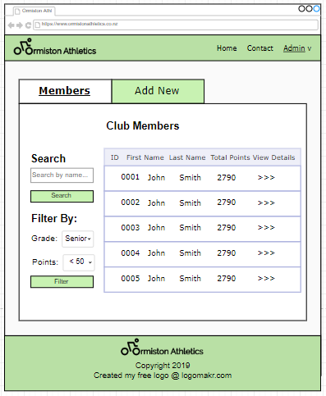
Justification of Chosen Design - Members Page
The search and filters are available so that the admins using the website can find the members they’re looking for easier and more efficiently, especially when there are more than 500 members. This eliminates the need of going through each individual member to find just one or a few. Similarly, search and filter are available for fees and events pages as well.
The individual members’ details however, can be viewed by clicking the ‘view details’ button where they are led to their own personal member report.
The header and the footer is the same throughout all my website pages. This is to create consistency, which is an important website design convention because as the user uses the website, the user becomes familiar with where the header / footer is, thus they know where to expect to login/logout, etc. which can help them navigate the website more easily.
I decided for the table that it should only display the ID, the name, and their total points for the season instead of displaying all their details. This is because having too much information on one table can overwhelm or confuse the admins using the website. It will also slow down the loading of the website which will affect the efficiency of the admin.

Slide 50
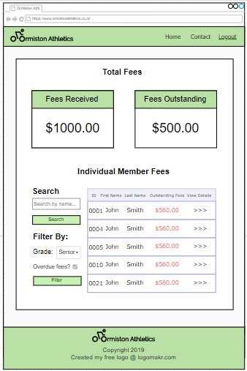
Justification of Chosen Design - Fees Page
The club fees received and outstanding fees are totalled and are the first thing in the fees page for ease of access to the admin. This will increase efficiency for the user.
The outstanding fees are in red because it is a common website convention. The red makes the fees pop, and it further alerts/reminds the user that the fees are overdue.
The buttons are the same colour and thickness throughout the website to create consistency in the website, which is an important design convention. This is so that when users become familiar with the website design, they recognise what a button looks like and thus, would expect it to work like a button.

Slide 51
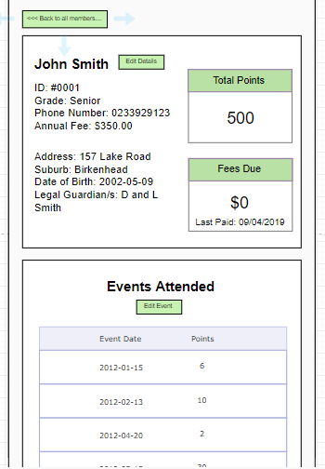
Justification of Chosen Design - Individual Member Page
Each member has an individual report which can be found by clicking the ‘view details’ button from either the members, fees, or the events page. This is where the admin will find the member’s details, total points, overdue fees, events attended, etc. It is also where the admin can edit any details or event points. By having all of the member’s details in one page, it makes it more efficient for an admin to find the necessary information for an individual member.
There is a ‘back to all members....’ button to go back to the members page in case the admin accidentally pressed on the wrong member, or when the admin has finished viewing, the admin can still go back to browse the rest of the website.
The total points and the fees due are displayed in boxes rather than just normal text so that it pops more, as it is likely what the admin needs to look at when viewing the member report. Thus, this makes the admin’s task more efficient.
The admin can edit the members’ details and event points in case there was a mistake when entering the data, or in case there are changes to the students details in the future. This is to foolproof and also futureproof the website contents.

Slide 52
Overall Justification of Chosen Design
My chosen and improved design is appropriate and suitable for the intended end users: administrators of Ormiston Athletics Club because it is accessible to all types of users, even those with visual impairments as alt-tags will be added for each image.
It is also suitable for administrators with varying levels of digital competency because the design is easy to use and understand, and the club data is easily accessible. The simple navigation bar and the drop down menu makes it easy for admins to navigate the website as well.
Copyright is also honoured in this design, with the logo credited in the footer and royalty-free images will be credited as well.
This design also follows appropriate and common website conventions such as the logo on the top left, and the login button on the top right. It also follows the C.R.A.P. design principles - Contrast, Repetition, Alignment, and Proximity, and has good use of colour and font sizes that adds to the aesthetic of the website and also helps make the content easier to read and understand.

Slide 53
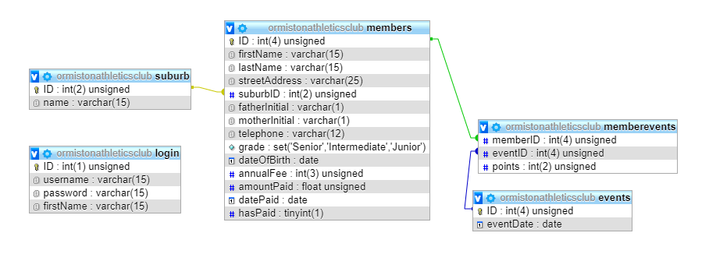
Database
Design and Relationships

Slide 54
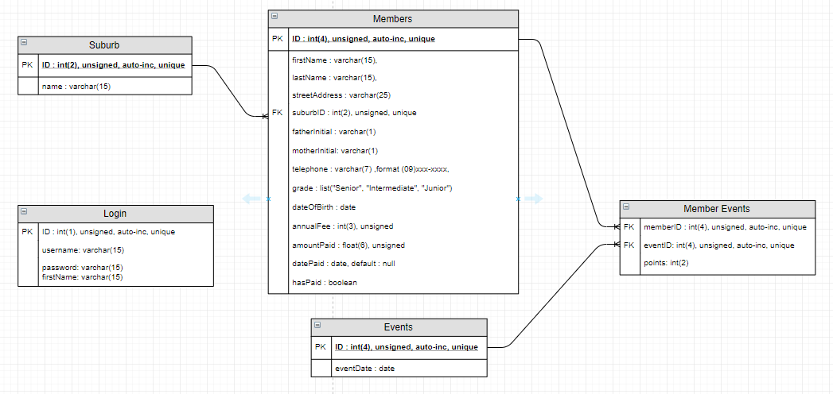
Database Plan
Before creating my database, I first had to plan/design it. I planned my database on Draw.io by designing the table and column names, as well as the types and attributes for each column.

Slide 55
Explaining Data Tables & Relationships
I have 5 tables in my database (as shown below). My main table being the ‘members’ table with multiple smaller tables such as ‘suburb’, and ‘events’ to avoid repetition of data which could cause inconsistencies (spelling errors, etc.), and a bridge table ‘memberevents’ to break up the many to many relationship between members and events also to avoid repetition of data thus would be inefficient.

Slide 56
Explaining Column Attributes
For all primary keys in my tables (ID’s), they all are auto-increment. This means that when a new record is inserted into the table, a unique integer will be generated automatically and will be assigned to this record. It is unsigned because we only want positive integers for member ID’s. This specific ID has a maximum of 4 characters because there were 591 members at the time and the club is still growing, thus a 4 digit integer will be needed.
The firstName, lastName, and streetAddress are all varchar. This is because we are expecting strings from the user’s input. firstName and lastName each has a maximum of 15 characters because while most first and last names are less than 10 characters each, there are some with slightly longer names. streetAddress is 25 characters because street names are slightly longer, plus the addition of the street number and ‘street/lane/avenue/etc.’
I decided to split the parents’ initial to fatherInitial and motherInitial because it would save more storage if the database only had to record 1 character each parent to a total of 2 characters altogether, rather than “L and L [last name]”. I just displayed this information in the L and L format.

Slide 57
Explaining Column Attributes (cont.)
The grades are in list format because I knew the grades were going to be set; it wasn’t going to be added to. Therefore, I decided to keep it in a list format.
The foreign keys in the members table have the same attributes as the primary key in their own tables. SuburbID specifically has a maximum of 2 characters because it is unlikely to have more than 99 suburbs in the Ormiston Area, however, there could be more than 10.
The dateOfBirth and datePaid are both dates because the expected input are dates. datePaid default is null because when members are first entered, they are unlikely to have all/any fees paid, therefore they don’t have a datePaid.
hasPaid is a boolean because the value can only be one of two things: True or False.

Slide 58
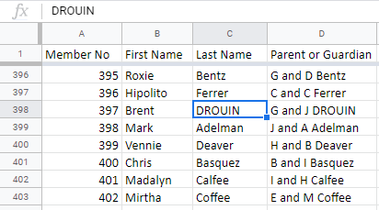
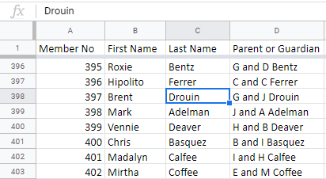
Cleaning Website Data
Cleaning website data before importing it into the database is important because not all the given data will be written in the correct format or data type when it is first handed to you.

Slide 59
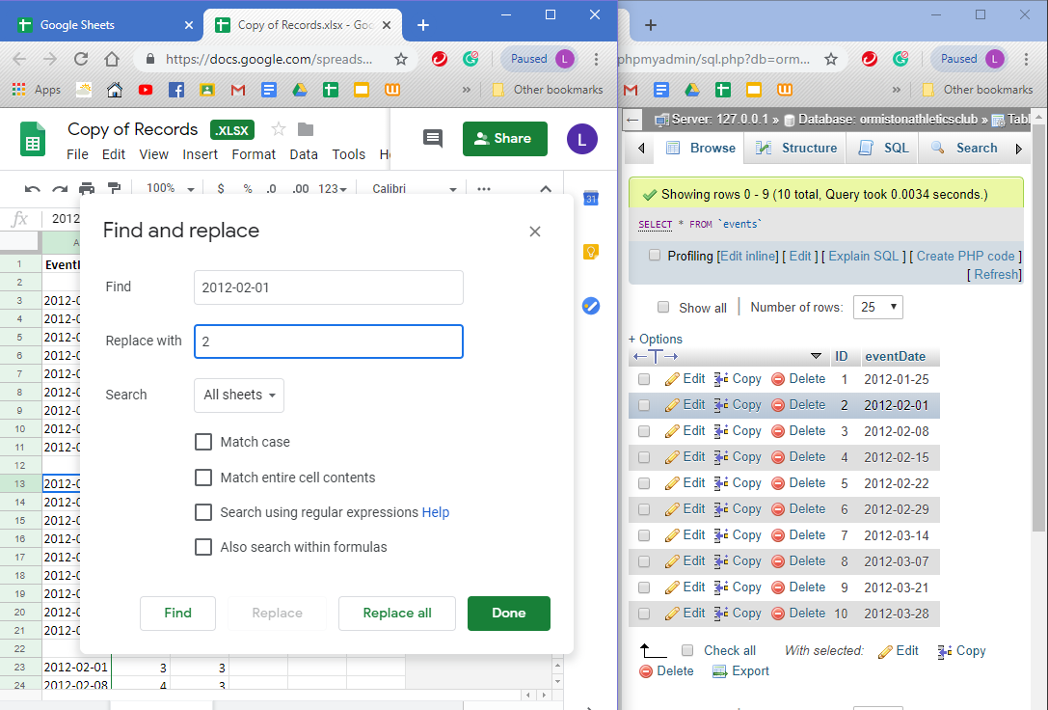
Importing Data into Database
Before importing data into the database, I replaced all my foreign key columns (e.g. event dates, suburbs, etc.) into their respective ID’s so that they will be linked to the other tables.

Slide 60
Website - Testing
Importance of Testing Website
Testing the website during and after coding then improving based on the test results and feedback is important to ensure the website is functioning as it is supposed to.

Slide 61
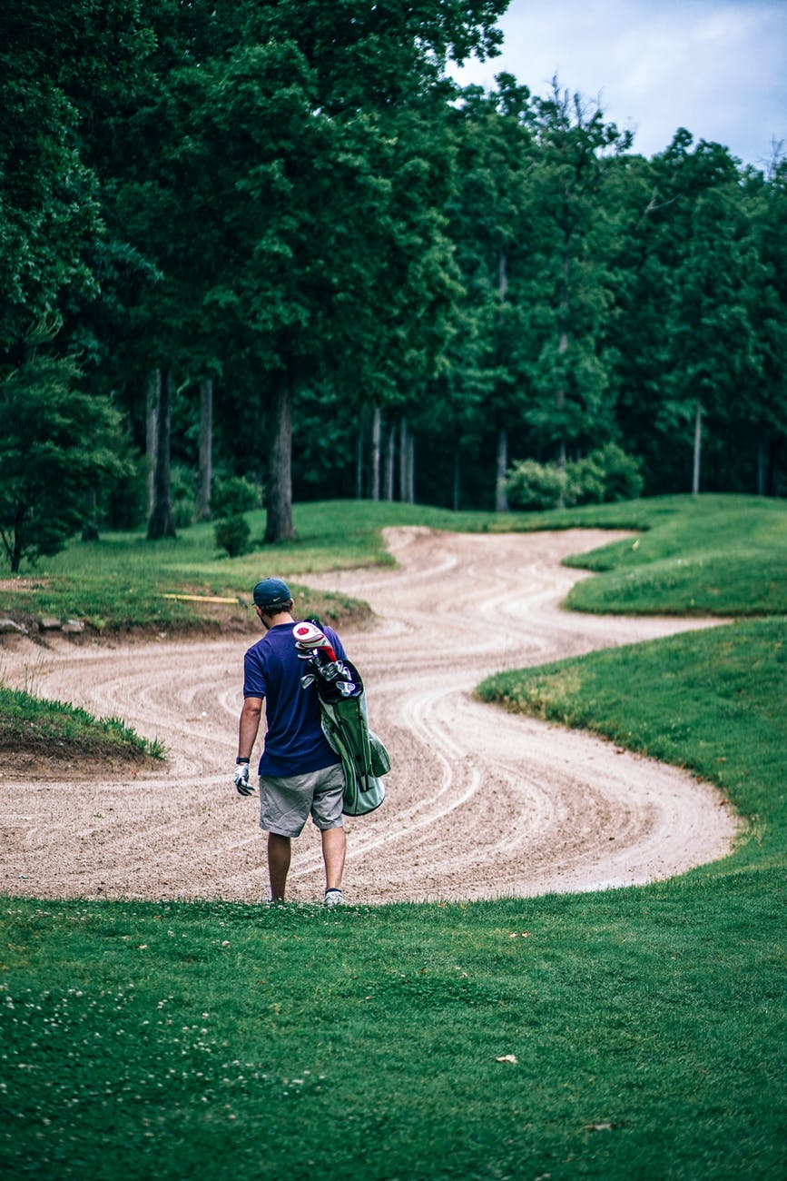
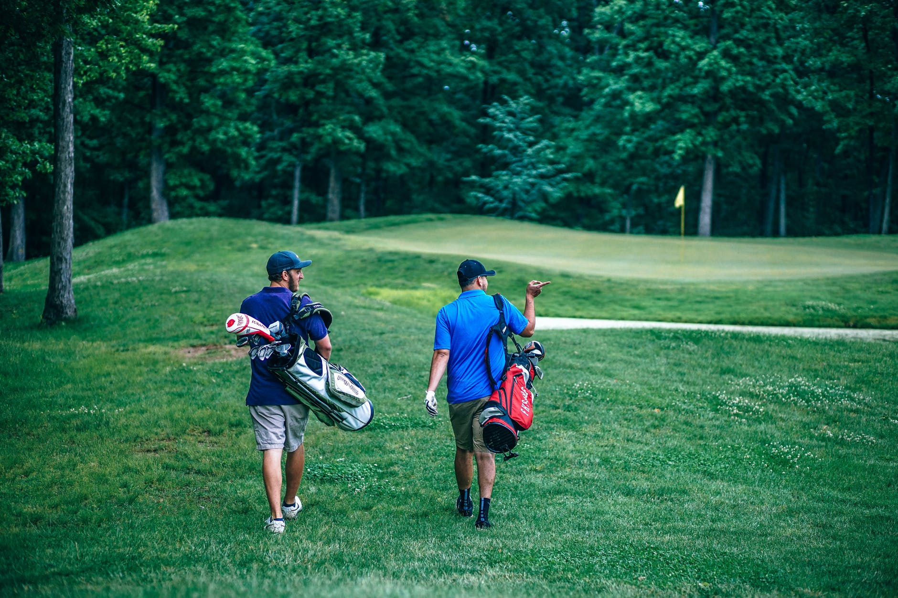
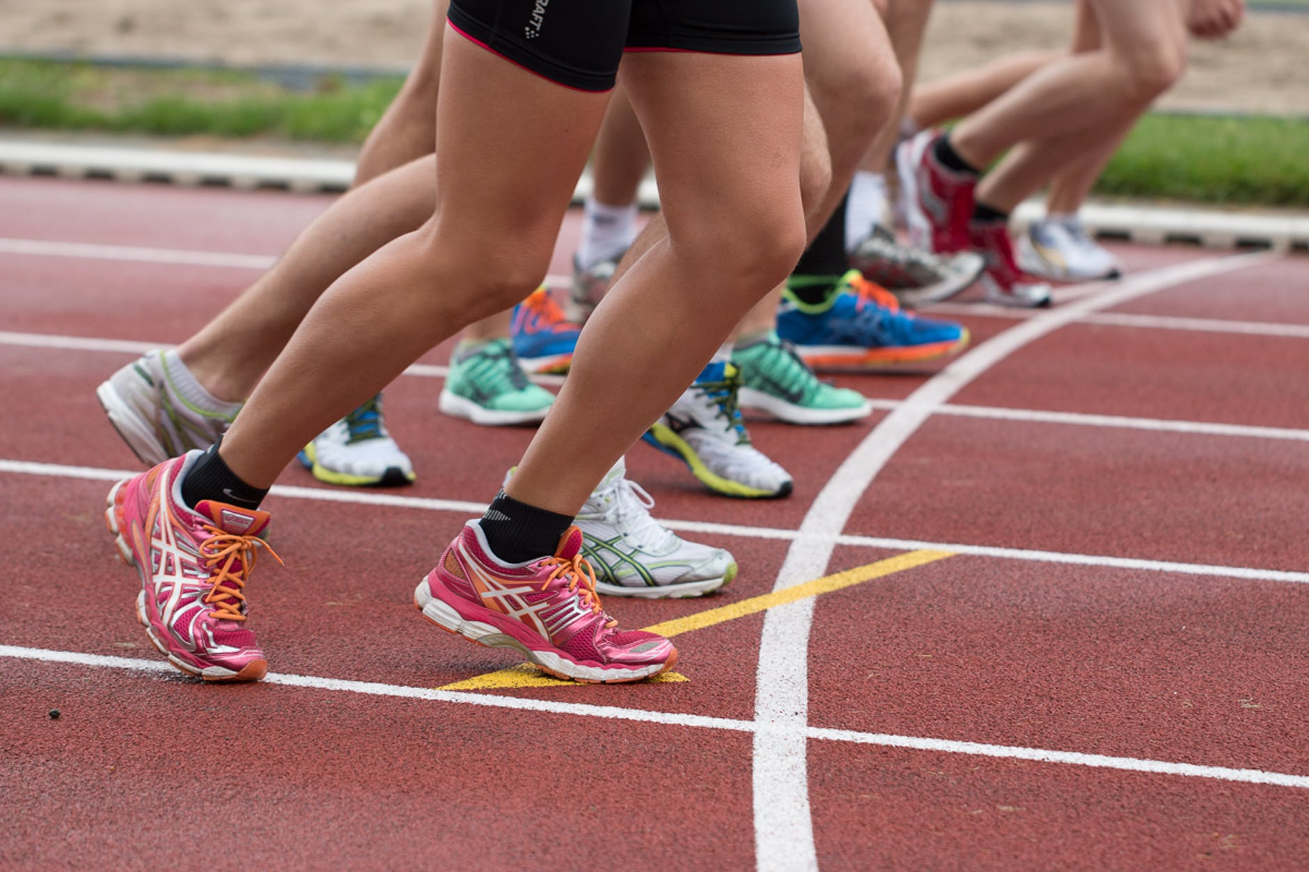

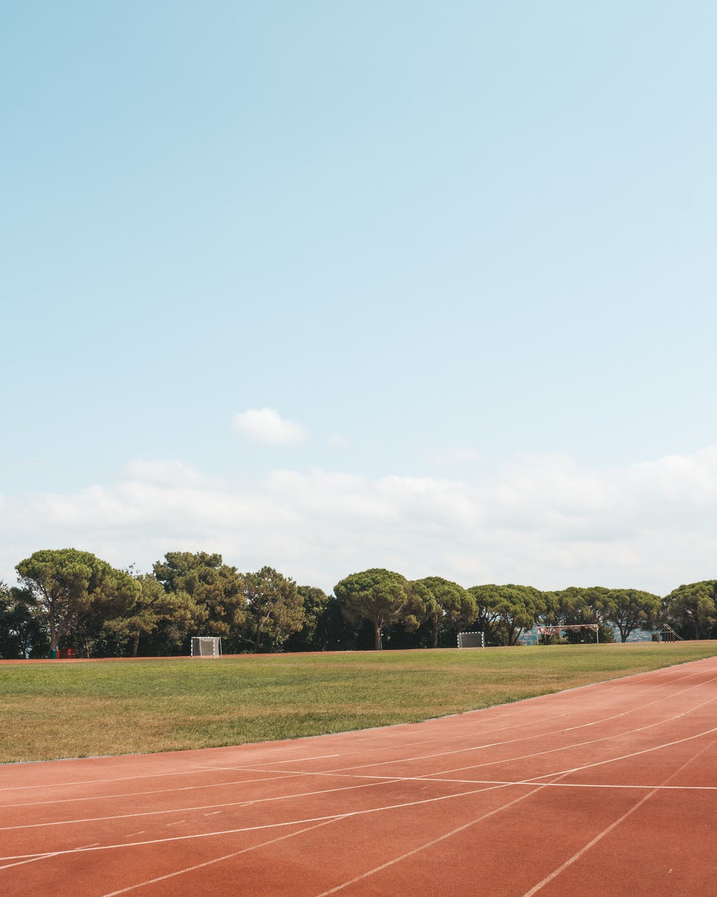
Images from Pexels.com for my Slideshow (all free to use)
https://www.pexels.com/photo/active-activity-adults-athlete-424725/
https://www.pexels.com/photo/people-doing-marathon-618612/
https://www.pexels.com/photo/activity-adult-alone-athlete-424762/
https://www.pexels.com/photo/club-course-equipment-exercise-424732/
https://www.pexels.com/photo/time-lapse-photo-of-man-riding-on-bicycle-733748/
https://www.pexels.com/photo/track-and-fields-2079612/

Slide 62



Resizing & Optimising Images
Since the images I picked out vary in size and orientation, I decided to resize all my images to fit my slideshow on my homepage on Photoshop so that it would look better on my website and would be easier to style later on.
The final image is then ‘Saved to Web’ on Photoshop to make sure the image is optimised for web to reduce loading times. This is so that users won’t have to wait for such a long time for the images to load.

Slide 63







Testing Login System
The login details on database
When dealing with sensitive data such as members’ phone numbers, etc., it is extremely important to make sure the login system is working as it should to protect these data.
Here you can see I have tested different combinations for the username and password and only one is correct.
Tested:
Correct username, correct password = logged in
Correct username, wrong password = not logged in
Wrong username, correct password = not logged in
Wrong username and password = not logged in

Slide 64



After logging in
Once logged in, the user is redirected to the index page and the ‘login’ button on the navigation bar has changed to the admin’s name with a dropdown menu.
I have also tested that the Members, Fees, Events, Member pages are not accessible unless logged in correctly. The pages redirect to the login page if the user is not logged in.
The dropdown also contains the logout button which I also tested to be working.

Slide 65



Testing Total Points and Displaying Tables - Member Page
I tested displaying my tables with data from my database to ensure the database is linked correctly and that my sql statement (right) → works correctly. I tested first by only showing the first 15 members instead of all 591 members to increase loading time at the time. I also tested the total points feature is calculating correctly by cross-checking the result with the calculator.

Slide 66


Testing form
After ensuring my table works, it was time to test whether my ‘Add New Club Member’ form was working and is inserting my data onto the database. As seen from the screenshots below, I first just printed all the input and a successful message to test if it worked (as seen below), then checked the database to further ensure that it worked. I then proceeded to check to see if it displayed on the website.
In database

Slide 67




Testing Members Initial Points
After testing that my form works, I realised that the member’s total points were wrong. It should be zero when they first join the club, so I wrote code to ensure that happens. I did this by inserting a blank (except for memberID) row in memberevents table and by changing the default of points to 0. I also of course had to test this out as seen in the screenshots below.

Slide 68

Testing Invalid Input for Forms
As users are unpredictable and have varying levels of digital competency, it is important to have error handlers (e.g. photo on the right) when users are expected to provide input to avoid incorrect/invalid input of data. I have made the forms required and added maximum lengths to each of the inputs where relevant, matching the maximum length to the database.

Slide 69


Testing Total Fees Received
Since the total fees received is calculated by code, I had to test this out by comparing it to the sum on the spreadsheet.

Slide 70


Testing Individual Club Member Page
Each club member has their own page which displays their events and their details. This can be accessed by clicking on the view details button on each member on any tables. I tested that this works by clicking on multiple member’s view detail button and ensuring it leads me to the correct page.

Slide 71





Testing the Edit feature
I also had to test the Edit feature on the Club Member page as it is possible that admins make mistakes when they are adding new club members in the form. I tested both editing the member details and the event points as seen below.

Slide 72


Testing Event Page / Search then Table
For my events page, I didn’t want to display all of the events at once on the same page, so I decided I wanted the users to search for a specific date and display that one at a time instead. For this to work, I needed a working search bar.
I tested that this search bar was working as seen on the right. (The date showing is temporary and for testing purposes only)

Slide 73





Adding New Event Inserting Event Members
This feature needed to be able to insert any number of members as well as insert into two different tables. I tested that this works and is displayed on the events page as seen on the right

Slide 74





Testing Search and Filter within Event Members
The search and filter in the events page is slightly trickier as it is only searching/filtering from a specific event, so I had to ensure that this works by testing it. As you can see on the right, I tested both and they were both successful.

Slide 75


Usability Testing
After creating my website, I decided to get one of my previous volunteers, Eugene, to give me more feedback in order to further improve my website.

Slide 76
Index Page
The slideshow works well. The buttons work and the images fit the website well.
Website description is a bit too short and vague.
The dropdown is also working as expected and looks like the design.

Slide 77



Contact and Login Page
The contact and login page is done well, functional, and is close to the design plan.

Slide 78


Members Page
The members page look almost identical to the design except for the addition of members’ grade in the table, however the addition was a great idea.
Dislike how only the first 15 members are shown. Would like to have pages or an option to choose which members to see first (e.g. sort by ascending ID, etc.)
The Search and Filter both work well, are easy to use, and look like the design plan.

Slide 79


Members Page - Add New
The add new member page is functional and the form is formatted nicely. Like how the placeholders are informative.

Slide 80



Fees Page
Similar to the members page, dislike how the table only shows the first 15 members. Would also like pagination or a sort by feature.
Even though the member has no outstanding fees, it is still in red - which seems counterintuitive.
Outstanding Fees checkbox is not clear. Does not ticking the checkbox mean filter members with no outstanding fees or filter both with and without outstanding fees?
Note: The green background is what happens when you hover over a member in the table.

Slide 81


Events Page
I like the idea of being able to search events directly by the event date, but if you don’t know the specific date, it is hard to find one.
Similar to the members page, dislike how the table only shows the first 15 members. Would also like pagination or a sort by feature.
Great how the search and filter works after searching the event - that it is only searching and filtering members in the selected event.

Slide 82




Individual Club Member page
When my volunteer clicked on ‘edit details’ button, he couldn’t tell it worked because he didn’t see the edit details tab open. (club member div too long)
The edits on the individual club member page redirects you to the member page, however the edit isn’t shown until you refresh the page - causes confusion.

Slide 83



Website Improvements
Taking the feedback I have received on board, I have made changes to my website that improve the functionality, usability, and design of the website.

Slide 84

Index Page
I added to my web description to give more information about Ormiston Athletics Club for any public users who visit the website. I also styled it by increasing line height and aligning text to justify to make it easier for users to read.

Slide 85

Adding ‘Grade’ Column to Tables
Despite the Grade column not being in tables in my original design, I decided to include it because it made sense to have the grade displayed if you were to filter members with it. Thus, I added it to all the tables displaying members (members, fees, events pages)

Slide 86
Pagination
I added pagination for all my admin pages with a table (Members, Fees, and Event pages). I made sure to add an active page to remind users which page they are on.
I also made sure to remove the back button on the first page and the next button on the last page, to let users know it is the first/last page.

Slide 87


Fees Page
The checkbox for the outstanding fees wasn’t very clear when it was unticked, so I changed it to a dropdown with an option for members with outstanding fees, without outstanding fees, and both.
I decided to only make those with outstanding fees red instead of the whole column so that the members with the outstanding fees stand out more to the user (the admin)

Slide 88


Events Page
Club Member Page
I added a dropdown with all the event dates as an extra option for admins who may not have a specific date in mind.
I made the member details div shorter so that you could see the edit details underneath when you clicked the edit button (below). The edit leads to the member page but doesn’t show the edit unless you refreshed it, so I also fixed that.

Slide 89


Second Usability Testing & Improvements
Testing your website not only once, but multiple times is important for continuously making improvements to your website. This is to ensure your users will be happy and satisfied with the outcome.

Slide 90


2nd Feedback
This time, I decided to get another of the volunteers, Ms. Al Salihi, to test my improved website to see if I could further improve it. This is what she said:
She got confused with the filters and thought it wasn’t working because she only chose one of the two filters. She didn’t like that you had to have both in order for them to work.
She likes that the outstanding fees are in colour.

Slide 91


2nd Feedback
The specific date for events were not clear as she thought they were for two different things. Maybe change the label for the second?
As she was scrolling through the given event dates, one of them didn’t have any members enrolled in it. However, it wasn’t clear.

Slide 92
2nd Feedback
The edit details were hard to find, it is a bit small.
If there are no outstanding fees, why is it still red?
The member ID is redundant - doesn’t need to be displayed.
The labels are getting lost in the text. There is no clear distinction between the labels and the actual details. Needs to be clearer so admins can find what they are looking for quicker.

Slide 93




Further Website Improvements
For all the filters with more than one filter option, I made it so that the user can choose to filter only one of the two filer options so that the user can have more freedom to choose what they want or don’t want to see.
I changed the label for second option for searching event to ‘Select Event’ instead of just ‘Event Date’ to make it clearer for the user.
I also added Javascript alerts to let users know if the events they searched for didn’t exist to also make it clearer for the user.

Slide 94
Further Website Improvements
The ID is no longer displayed on the club member page.
I made the edit details bigger so that it is more noticeable, thus easier to find.
I increased the font-weight of the labels to make it more distinct compared to the members’ details.
I made the outstanding fees black instead of red when all the fees are paid because it is less alarming, thus doesn’t need the red.

Slide 95

Third Usability Testing
I then tested my website on a volunteer’s device to ensure I test for different device as well.

Slide 96



Feedback and Improvements
The images in the slideshow took a little long to load, and this was because my images were saved as png file and because the file size exceeded 600KB.
I fixed this by exporting my images as JPG which is more suitable for websites as it had a smaller file size thus will load faster.
Some of the links in my website also weren’t working on different devices because I included the folder name instead of just the file name. I fixed it as seen on the screenshots on the left.

Slide 97
Final Website Testing
Recap of Website Requirements:
Easy to use/understand ✔️
Accessible for all types of users ✔️
Dynamically linked to club database✔️
Functional / Be Able to:
Insert and edit kids details, scores, and fees✔️
Display total fees received and total outstanding fees✔️
Display a list of all kids with overdue fees and showing the amount owed✔️
Display a table of members with their total points for the season✔️
Search an event and display all players participated for that event ✔️
Search a kid to bring out their points, fees, view their individual report ✔️
In addition to testing your website with your volunteers, it is also important to test the accessibility of the website using a variety of different softwares, browsers, and standard procedures.

Slide 98

Honouring Copyright
All the text displayed on the website and all the code used was written by me in my own words. While I did get coding help from the internet (specifically W3Schools and Stack Overflow forums), I wrote the code based on my understanding from these websites instead of copying and pasting.
I made my logo using Logomakr which is a free logo making platform offering many different icons and graphics. I have honoured copyright by providing credit as well as linking the website in the footer section of all my pages on my website.

Slide 99

Honouring Copyright - Images
I have honoured copyright by ensuring the images I have used for my slideshow were all free to use by getting them from a Royalty Free Images Website (Pexels), as well as clearly labelling each image source on the corner of the slideshow that leads the user directly to the owner of the photo.

Slide 100








Colour Blindness Simulator
Normal
As I don’t know anyone with colour blindness, I have ensured my site is accessible to colour blind users by using a colour blindness simulator which simulates what my website would look like to a colour blind person. As you can see from my screenshots below, the red for outstanding fees in some of them aren’t as distinct as others, however the filter for viewing members with outstanding fees only resolves that. Other than that slight issue, my website is still easy to use and navigate for colour blind users as the text are still readable.
Red-Weak/Protanomaly
Green-Weak/Deuteranomaly
Blue-Weak/Tritanomaly
Red-Blind/Protanopia
Green-Blind/Deuteranopia
Blue-Blind/Tritanopia
Monochromacy/Achromatopsia
Blue Cone Monochromacy

Slide 101

Images Alt Tags
I have ensured my website was accessible to users with visual impairments by adding descriptive alt tags for each image on my website so that it will be able to be read out loud by the users’ screen readers so that they won’t miss out on the images on the slideshow.

Slide 102

Testing Website on Multiple Browsers & Screen Size
I tested my website on two different browsers and two different screen sizes to ensure it functioned properly on different settings. My main concern was that the font I chose wouldn’t work on different browsers other than Google Chrome as the font was from Google Fonts. However, as seen on the screenshots below, this was not an issue. The rest of my website was functioning as it should and the overall design of my website stayed the same so changes in browser and screen size were not a problem.
Browser: Google Chrome Screen size: 1366 x 768
Browser: Microsoft Edge Screen size: 1280 x 720

Slide 103
Final Website Evaluation
My final website has met the website requirements provided by the end user (admins) that I have set out at the beginning of this document. My website is easy to use and understand, because I have researched and implemented common website conventions (such as keeping the login button on the top-right, etc.) in my designs, as well as regularly tested my website (with the help of volunteers) to test the usability and improved multiple times based on these feedback.
My website also has many features to stimulate interest in my website as well as to make the end user’s experience easier - for example: a slideshow in my homepage, search bars and filters in my admin pages, pagination for tables. The website is also dynamically linked to the database - which makes the website future-proof, as well as makes it easier for the admin to view/edit/add data.
The website is also accessible to all types of users - including people with colour blindness or other visual impairments. I have done this by testing using a colour blind simulator (and ensuring all content was still readable and understandable) and adding alt tags on images. It is also accessible to users with varying levels of digital competency as the website was easy to use/navigate.
I have also complied to copyright by ensuring that all the images in my slideshow are properly credited. My website also meets the website specifications as seen on the final website test screen recording.

Slide 104

Final Website Test
https://drive.google.com/file/d/1HjBJoGnn_d2XJj3miUrmnFaMR_o1NqLa/view?usp=sharing

